Slide 1

Implementation Strategy for USD-Collateralized Stablecoin on Ethereum Layer 1 & Linea
Leveraging Consensys Products for Secure and Scalable Solutions
TheNewAutonomy
August 2024

Slide 2
Objectives…
… extend the availability of USD-collateralized stablecoin from Ethereum to Linea
… ensure security of the stablecoin on and between Ethereum and Linea
… provide good liquidity management between chains
… provide a seamless user experience between networks
… provide future options to issue a new Linea native token
… leverage the tools and technologies of Consensys

Slide 3
Questions
How quickly do I want to be available on Linea?
How much code and infrastructure do I want to create and maintain?
Is my token on Linea a plain ERC20 or is there custom functionality?
i.e. Address blocking, Regulatory (KYC, AML features), reporting, liquidity balancing functions.
4. Liquidity management, compliance, integrating with wider ecosystem and community
Notes:
Start by asking to consider some fundamental questions that will help to determine the choice of phases, bridging options and timelines

Slide 4

Bridge Implementation -
Phases

Slide 5
Bridge Phases
Phased implementation approach
Initial Deployment on Linea via Bridging
Seamless User Experience
Native issuance on Linea
1
2
3
Canonical Token Bridge to Linea
Linea Message Service for secure communication between networks
Focus on security and liquidity during bridging
Integrate with MetaMask for a simple wallet experience
Utilise Infura for reliable data availability and APIs
Issue a new token on Linea
Explore the role of Consensys Rollups and zxEVM to enhance scalability and security
Notes:
Explain that depending on the bridging approach adopted, these three phases happen sequentially or concurrently but can always be treated as distinct work-packages.
The details of these phases vary and will be discussed.
Phase 3 may not be required. Determined by the details of phases 1 and 2 and future business decisions by the client.

Slide 6
1
Initial Deployment on Linea via Bridging

Slide 7

Bridge options
Linea Native Bridge
Third-Party Bridge
Flexible bridging options.
Canonical token on Linea.
Default
Custom Token
Custom Bridge & Token
LI.FI and Socket aggregators
Bridge providers supported
Hop
Connext
Squid (Axelar)
Across
MetaMask Bridge
Simple User Experience
Fast and Cheap for user
Bridge & Swap
Notes:
Linea Native Bridge to create a canonical token but there are three ways to use the bridge.
Third-party bridge providers that are supported by LI.FI or Socket, ensuring the Linea Canonical token is used.
MetaMask Bridge isn’t a separate bridge but present what it is and why it’s relevant.

Slide 8
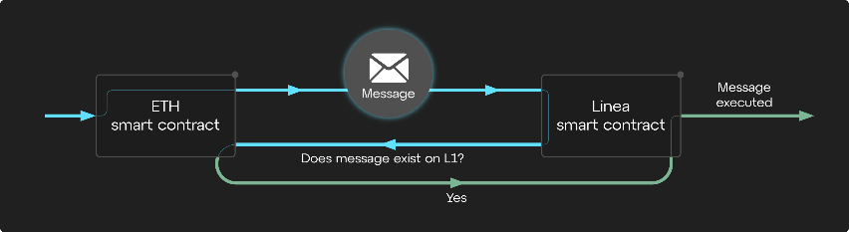
Phase 1
Initial Deployment on Linea via Bridging – How it works
Canonical message service
Components
Smart Contract on Ethereum
Smart Contract on Linea
Postbots messaging service
Process (birds eye view)
Call sendMessage(…) method in source chain MessageService.sol contract
Args (_to, _fee (optional), _calldata (created with abi.encode(…))
Postbot listens for call then delivers message to contract on target network
Contract executes
If fee paid, claimMessage(…) triggers automatically, otherwise call manually to pay fee
Asset is delivered to _to address.
Extra check to ensure call came from MessageService onlyMessagingService
Optionally, use onlyAuthorizedRemoteSender to ensure trusted contract sent message, such as from a dApp contract on source chain
1
Notes:
Cross chain messaging and on-chain contracts

Slide 9
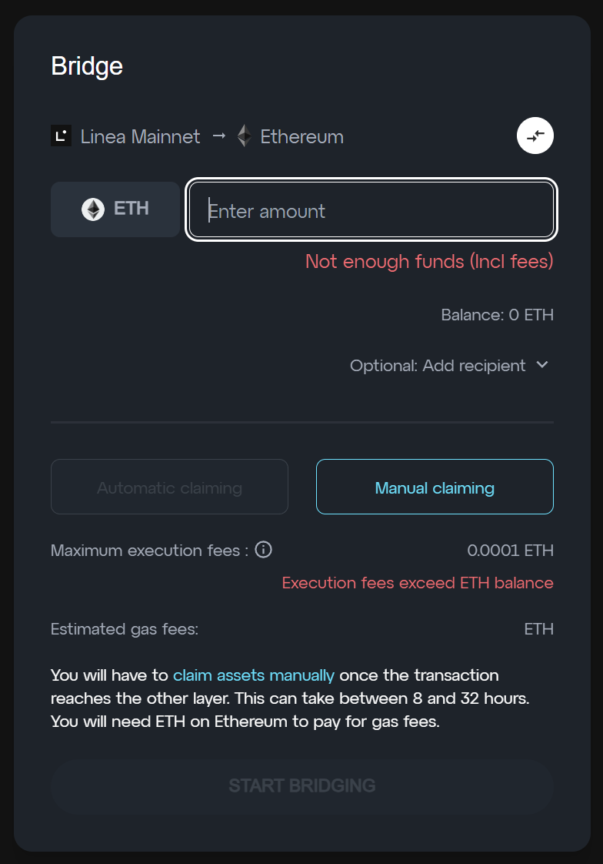
Phase 1
Initial Deployment on Linea via Bridging – Canonical Token Creation
Default Linea bridged token
Benefits
Codeless
Tried & Tested bridging
Standard bridge URL and interface for users
Operate alongside other popular bridged tokens
Limitations
Bridged token is a basic wrapped ERC20 token
No custom logic in bridged token
1
Notes:
- Simplest option if opting for Linea Native Bridging
- Get going quickly with no need to write or deploy a new token for Linea

Slide 10
Phase 1
Initial Deployment on Linea via Bridging – Canonical Token Creation
Custom bridged token
Benefits
Add custom logic to bridged token
Tried & Tested bridging
Standard bridge URL and interface for users
Operate alongside other popular bridged tokens
Limitations
Need to write, test and audit custom ERC20 smart contract for Linea
Need to work with bridge team to set up bridged token
Can’t be carried out if already bridged to Linea
Considerations
When providing a custom bridge UI, use a dedicated Infura node for maximum data access reliability and performance
1
Notes:
More work including engineering and support time
Increased risk due to custom code
Support for custom features in the bridged token
Longer timeline to allow for engineering, testing and audit times

Slide 11
Phase 1
Initial Deployment on Linea via Bridging – Canonical Token Creation
Custom bridge and token
Benefits
Leverage tried, tested and audited bridge code base
Write custom ERC20 smart contract for Linea
Adjust bridging logic and functionality as needed to support bridged token
Freedom to design a unique user experience through a new UI
Limitations
Need to write, test and audit custom ERC20 smart contract for Linea
Need to modify, audit and maintain bridge code and infrastructure
Need to work with bridge ensure token can’t be bridged by default bridge
Increased responsibility, legal and financial risk maintaining custom solution
Token no longer found in default bridge alongside other popular tokens
1
Notes:
The biggest undertaking in terms of time and cost
May negate the need for a later native token deployment
A very custom experience for users
If wanting to support MetaMask Portfolio Bridge, would need to comply with MetaMask Bridging requirements to get registered
Highest risk due to the code and infrastructure estate being developed and maintained

Slide 12
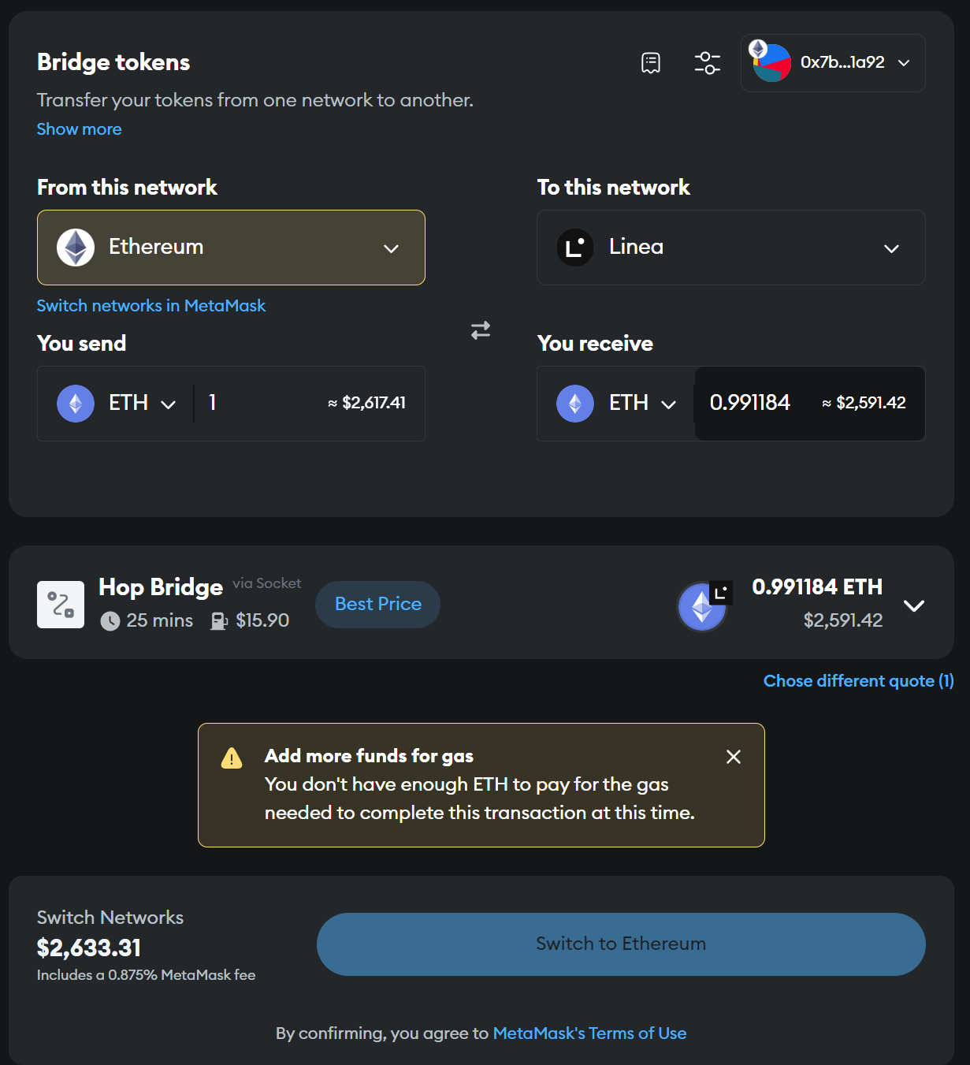
Phase 1
Initial Deployment on Linea via Bridging - MetaMask
MetaMask bridge
Uses the Li.FI and Socket aggregators to find the cheapest bridge route.
Bridge providers supported by LI.FI and Socket that support Linea.
Hop
Connext
Squid (Axelar)
Across
Benefits
Very simple user experience
Finds the cheapest route to bridge via multiple bridges
Can swap and bridge as a single transaction
Faster than the Linea Native Bridge
Doesn’t require a manual claim action on the receiving network
1
Notes:
Not a bridge directly but uses LI.FI and Socket aggregators to provide a single simple bridging experience
Need to be listed on one or more supported third-party bridges

Slide 13
Phase 1
Initial Deployment on Linea via Bridging – Third Party
Third-Party bridges
Hop bridge
Hop DAO to get token added to bridge
Uses a non-canonical Hop bridge token to bridge
Uses AMM's on each chain to balance price and availability
Arbitrage between networks maintains price
Connext
Messages are aggregated to Ethereum L1
Fraud protection with fallback to Linea bridge
Routers front run the transfer using canonical tokens
Squid (Axelar)
Squid runs on Axelar's infrastructure
1 week turn-around to whitelist a token via online form
Canonical token
Across
Funds escrowed in a settlement protocol
Request for quote, relayers fulfil quote.
1
Notes:
Need to engage directly with third party bridge providers.
These bridges use the canonical token created by Linea Bridge, using LPs to provide bridged token on Linea.
Included here only as a reference and to explain the relationship with MetaMask and Linea Native Bridge.
Worth mentioning that there are other bridges such as Symbiosis which are independent

Slide 14
2
User Experience & Compliance

Slide 15
Phase 2
User Experience
dApp UI – Best Practice
Build and dApp to be user-centric. Consider user flows.
Independent UI evaluation (i.e. Bunnyfoot) for an intuitive customer experience
Mobile and desktop experience
Accessibility such as color blindness, visually impaired, mobility restricted users
Multilingual support in dApp
Integration into popular tools (PDF, Excel etc)
Minimize number of user actions, including transactions to sign
Documentation, user videos, user guides, onboarding guides
Integrate broadly. Consider wider ecosystem and their user base.
Optimize contracts to be cheap and fast
User support
2

Slide 16
Phase 2
User Experience
Metamask
Popular / familiar interface
Snaps – Option to create a custom snap utilizing features of the token
MetaMask bridging
Audited and trusted
Support for hardware wallets
2
Infura
Reliable node with high availability for a better customer experience
Different node types including full Archive Nodes
Low congestion with a dedicated node
Scalable infrastructure
Consistent performance
Notes:
MetaMask is a popular and familiar tool for most EVM blockchain users
Snaps to be considered if needing to offer a dApp that provides a custom interactive experience with Linea, such as collecting information about a token or account or interacting with custom token logic
MetaMask bridging already discussed
Infura for any dApp developed to ensure there’s a node dedicated to supporting the custom bridge or web application
Rate limit Infura node

Slide 17
Phase 2
User Experience
Dilligence
Customer confidence from a reputable auditor and professional testing tools
Smart contract audits by highly experienced and qualified code auditors
Tools for analysing smart contracts for common vulnerabilities
Automated scanning tools
Continuous monitoring and verification for security vulnerabilities
Professional testing techniques such as fuzzing
2
Protect the user
Bug bounty programs
For any tokens held, use multisig or smart wallet
Provide education to users regarding online safety such as phishing scams and benefits of hardware wallets
Ensure KYC/AML compliance requirements met where needed. Bake into token? Whitelisting or blacklisting?
Ensure any required licensing is in place
Consider regional regulatory and legal requirements such as GDPR in Europe and Standard Contractual Clauses for international data transfers
Work with regulators (i.e. SEC in the USA, FCA in the UK, DNB in the Netherlands)
Financial reporting, particularly related to collateral
Defence in Depth for infrastructure, pen-testing, fuzzing, DDoS mitigation, strict WAF rules.
Notes:
Dilligence provides a best in class auditing service and self-service tools to build confidence in what’s developed.
Consider bug bounty programs, smart and multi-sig wallets for any tokens managed on Linea

Slide 18
3
Native Issuance on Linea

Slide 19
Phase 3
Native Issuance on Linea
Is it required?
Was a custom contract deployed in phase 1?
What is the motivation behind a new native token?
3
The token
A new ERC20 token deployed to Linea
Original canonical token remains on Linea and bridge (two tokens). Not all tokens will be bridged and converted
Burn the native token on Ethereum and issue a new token on Linea
- Bridge original token back to Ethereum
- Send to contract to burn on Ethereum
- Canonical Message Service communicates to Linea the quantity of tokens received and sender address
- Contract on Linea mints and sends new tokens to owner’s wallet
Consider underlying collateral, whether it’s combined or separate and how to manage
Notes:
If a custom contract was deployed in phase 1 then it may negate the need for a new token issuance.
If the motivation is to have custom capabilities in a Linea token, those capabilities may be added in phase 1 in the custom contract.
If the motivation is to have separate management of the collateral or a separate economic or business model then this strongly supports a separate later native token

Slide 20

Liquidity Management

Slide 21
Rebalancing
Liquidity challenge
Bridges need Liquidity on Linea to fund transfers
Liquidity fragments between chains, reducing availability
Reduced availability increases risk of slippage and volatility
Tools and Strategies
Seed liquidity on Linea via AMMs
Incentivize Liquidity Providers with rewards via yield farming and pool staking
Automate liquidity rebalancing between networks
Partnerships with Market Makers
Continuous monitoring and review
Support bridges that use the canonical token
Notes:
Insufficient liquidity on Linea could make bridging impractical or too costly.
Not having several deep pools on Linea also increases risk of slippage and volatility as liquidity is added, removed and traded in AMM.

Slide 22



AMMs
Supporting liquidity on Linea via AMMs
Why?
Deep pools on AMMs ensure liquidity is available to fund transfers
Hop Bridge requires Hop tokens paired with Canonical tokens
Pools support arbitrage to balance prices
Deep pools reduce volatility
1
How?
Partner with AMM providers to maximize benefit
Create small number of deep pools pairing token with quality assets such as ETH
Incentivize Liquidity Providers with rewards such as ETH and additional stables
Build partnerships to jointly fund pools and offer joint rewards
Notes:
- Crucial to incentivize liquidity providers. Why support your pool and not another token pool?
- Deep pools stabilize price and ensure bridges have access to the liquidity needed to support the bridging transactions

Slide 23
Program of Liquidity Provisioning
Market takes over, expanding pools and rebalancing through arbitrage between networks
Increase pool size through investment
Create pools with seed liquidity on AMMs

Slide 24
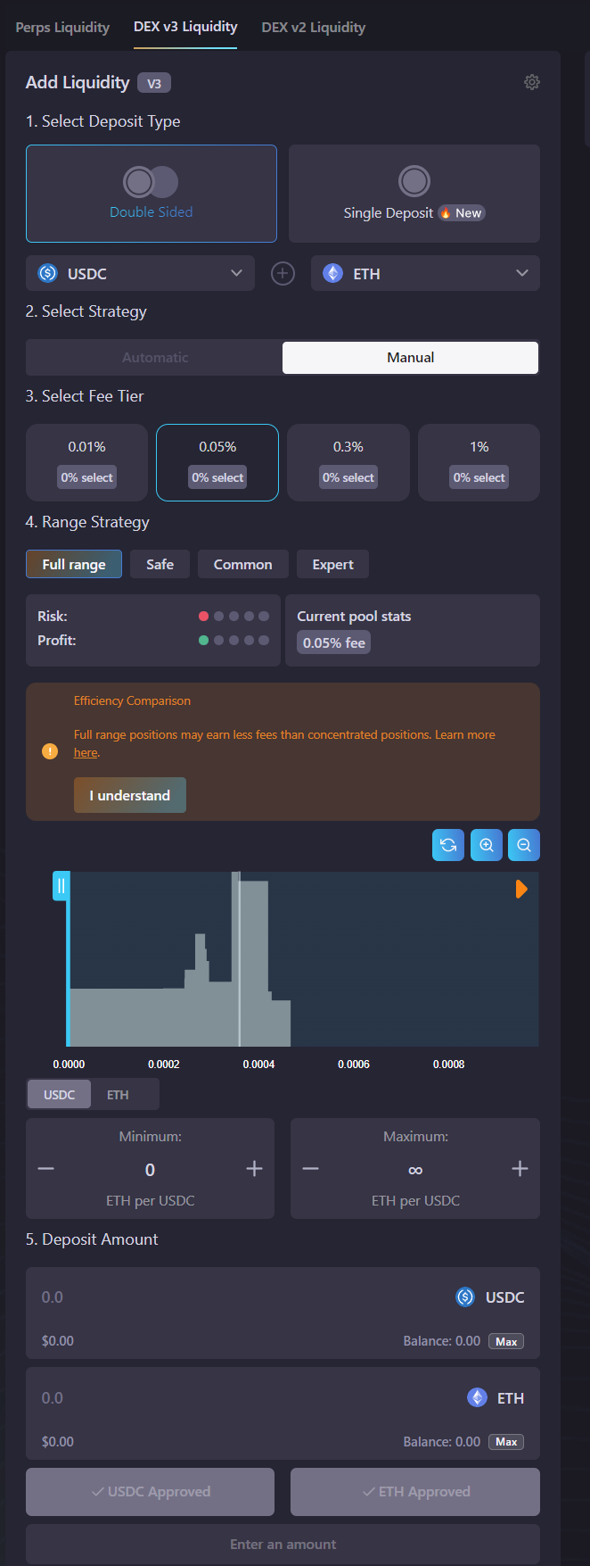
Actively work with AMMs
Connect with AMM teams
Identify listing requirements and partnership programs
Create Liquidity pools
Small number of deep pools of quality assets paired with token
Incentivize Liquidity Providers
Work on reward programs for LPs and farms such as Liquidity Mining
Build out a healthy ecosystem
A healthy ecosystem underpins bridges and the token itself
Notes:
Need to provide sufficient quantity of token and its paired asset such as ETH
Need to provide incentives to Liquidity Providers to buy and hold sufficient tokens in the pool long term. Trading fees plus additional rewards

Slide 25
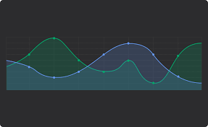
Automated Rebalancing
Use tools and strategies to rebalance between networks
Why?
Risk of fragmentation can reduce availability of tokens on Linea
Could disrupt bridging if liquidity is unavailable
Markets can change quickly and so the need to detect, and response must be fast
1
How?
Design strategy including liquidity levels on Linea to be maintained
Smart contract on Linea and Ethereum monitors availability, price or volume
- Triggers when liquidity is low or on a schedule
- Tx volume or slippage via oracles is high
- Complex algorithmic monitoring and balancing or predictive
Consider gas fees, performance and benefits of each approach
Can be as simple as a liquidity threshold or as complex as off-chain ML
A powerful tool for building a secure ecosystem

Slide 26
Market Makers
Partnering with market makers to support the economy
Why?
Market Makers build out deep order books, ensuring buy and sell orders are available for the market and supporting larger transfers to balance prices
Reduces volatility and slippage
Encourages users to trust, trade and use a new coin
1
How?
Partner with Professional Market Making businesses and/or DeFi markets
Reward market makers either through fees or revenue sharing
For professional businesses, check contracts and responsibilities, set targets
Work with Market Makers on CEXs and DEXs which also opens up to trading bots

Slide 27
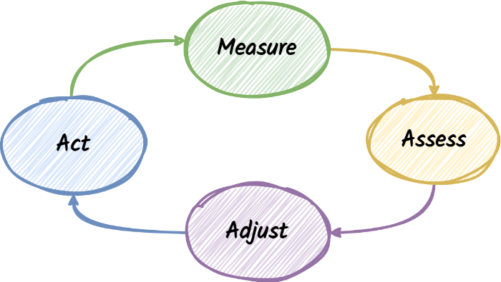
Monitor & Review
Have a program of monitoring and review in place
Why?
Markets change quickly, stables risk getting unpegged
New regulations
Create feedback loops to adjust liquidity
1
How?
Develop internal program of monitoring and reporting
Work with Market Makers and have frequent two-way communication
Have plans in place for conditions. Planning mid-event is the worst time.

